Slide 1
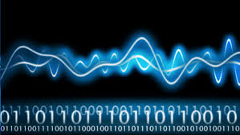

TON DUC THANG UNIVERSITY
FACULTY OF ELECTRICAL AND ELECTRONICS ENGINEERING
402084 DIGITAL IMAGE PROCESSING
CHAPTER 1: DIGITAL IMAGE PROCESSING INTRODUCTION
Vu Anh. Le, Phd.

Slide 2
OBJECTIVES
Known properties of the digital image
Know the digital image sensor and digital image acquisition.
Understand the light characteristics and human visual system
Understand the way to represent a digital image and color space.

Slide 3
CHAPTER 1: Digital image processing introduction
1.1 INTRODUCTION ABOUT DIGITAL IMAGE PROCESSING
1.2 CAMERA AND HUMAN VISUAL SYSTEM
1.3 REPRESENT A DIGITAL IMAGE AND COLOR SPACE

Slide 4
Introduction about Digital Image Processing
A continuous image is 2D function
1D: f(t) is a function f that depends on time t.
2D: f(x,y) is a function f that depends on the spatial (room) coordinates x and y.

Slide 5
Introduction about Digital Image Processing
Ex)

Slide 6
Introduction about Digital Image Processing
An example of a digital image

Slide 7
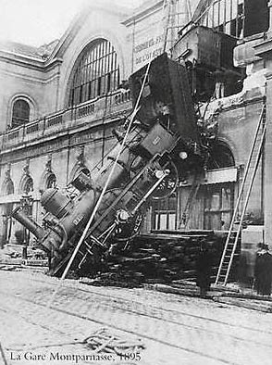
Application of Digital Image Processing
Goal of computer vision is to write computer programs that can interpret images
Can computers match (or beat)
human vision?
Yes and no (but mostly no!)
humans are much better at “hard” things
computers can be better at “easy” things

Slide 8
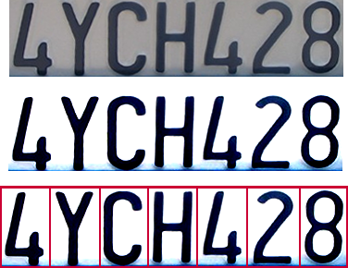
Application of Digital Image Processing
Optical character recognition (OCR)
Technology to convert scanned docs to text
License plate readers
http://en.wikipedia.org/wiki/Automatic_number_plate_recognition

Slide 9
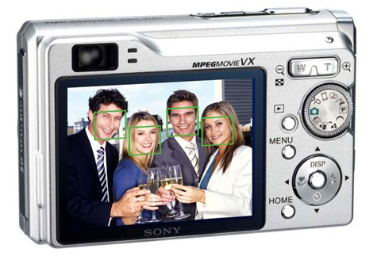
Application of Digital Image Processing
Face detection
Many new digital cameras now detect faces Canon, Sony, Fuji, …

Slide 10
Application of Digital Image Processing
Smile detection
Sony Cyber-shot® T70 Digital Still Camera

Slide 11
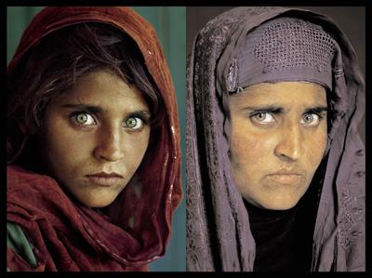
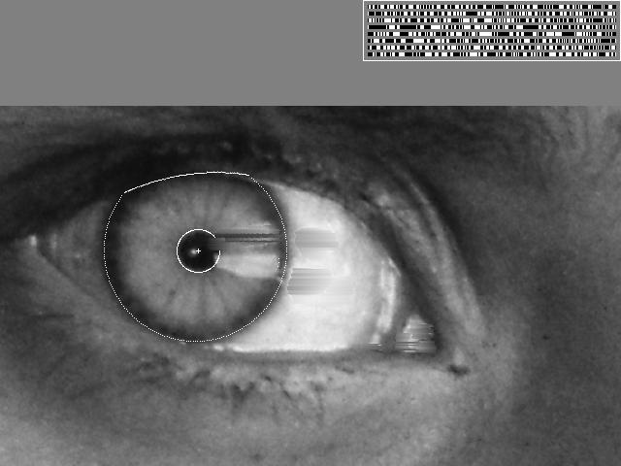
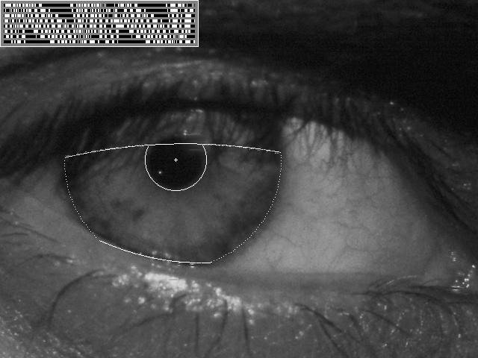
Application of Digital Image Processing
Face recognition
“How the Afghan Girl was Identified by Her Iris Patterns”
Who is she?

Slide 12
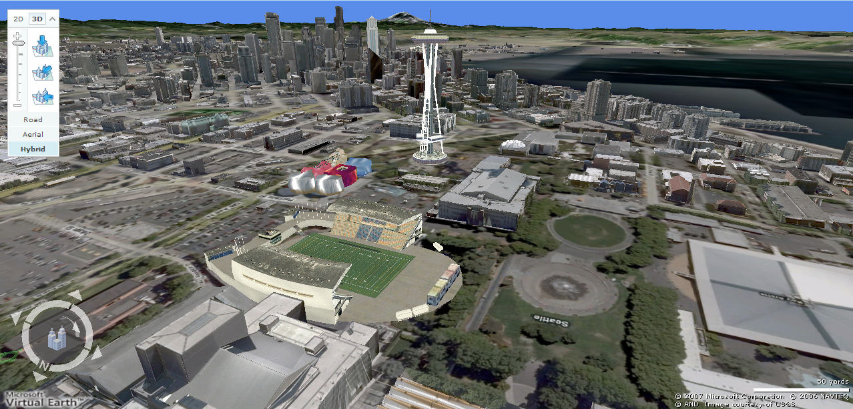
Application of Digital Image Processing
Earth viewers (3D modeling)

Slide 13

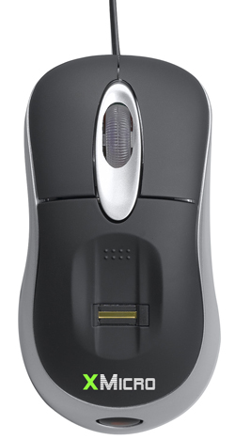

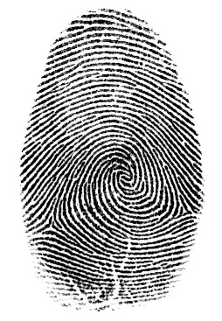
Application of Digital Image Processing
Login without a password
Face recognition systems now beginning to appear more widely http://www.sensiblevision.com/
Fingerprint scanners on many new laptops, other devices

Slide 14
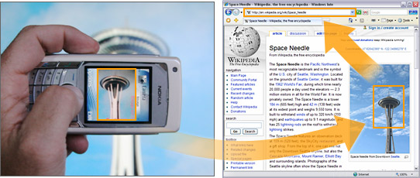

Application of Digital Image Processing
Object recognition (in mobile phones)
This is becoming real:
Microsoft Research
Point & Find, Nokia

Slide 15
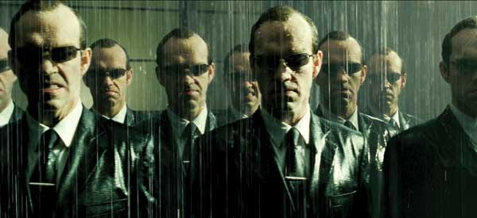
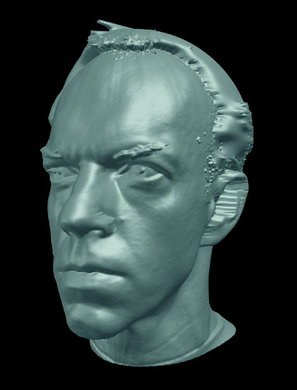
Application of Digital Image Processing
Special effects: shape capture

Slide 16
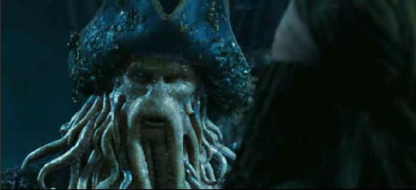
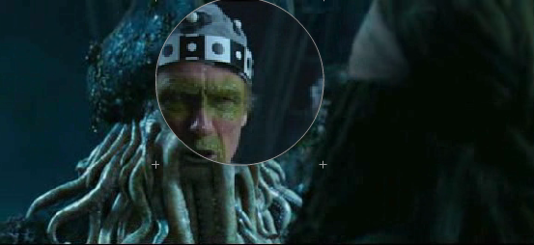
Application of Digital Image Processing
Special effects: motion capture

Slide 17
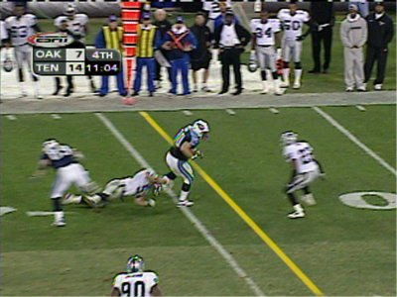
Application of Digital Image Processing
Sports analyse
Sport vision first down line

Slide 18
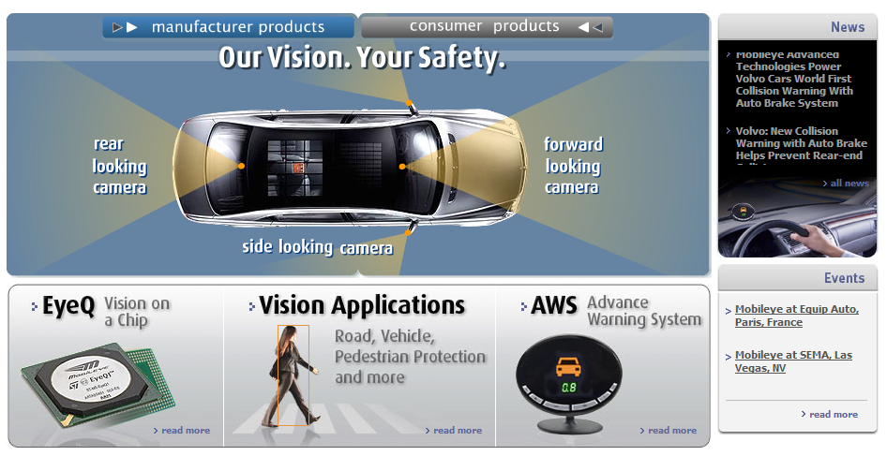
Application of Digital Image Processing
Object recognition (in mobile phones)
Smart cars
Vision systems currently in high-end BMW, GM, By 2010: 70% of car manufacturers.

Slide 19
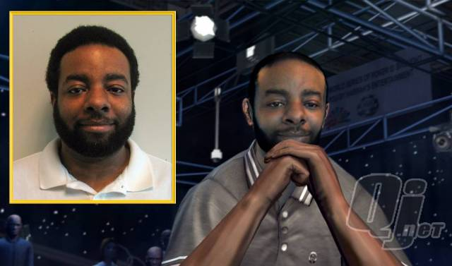
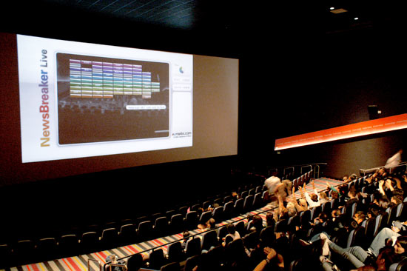
Application of Digital Image Processing
Vision-based interaction (and games)
Digimask: put your face on a 3D avatar.
“Game turns moviegoers into Human Joysticks”

Slide 20
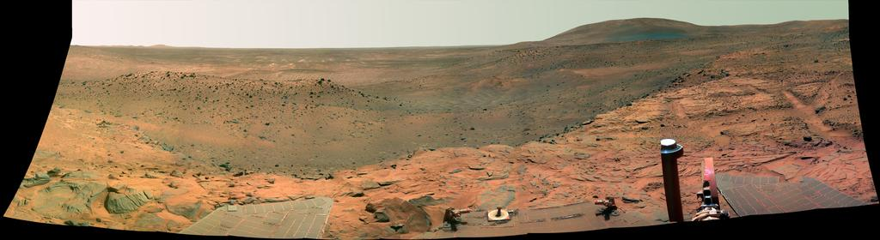
Application of Digital Image Processing
Vision in space
Panorama stitching, 3D terrain modeling
Obstacle detection, position tracking
NASA'S Mars Exploration Rover Spirit captured this westward view from atop a low plateau where Spirit spent the closing months of 2007.

Slide 21
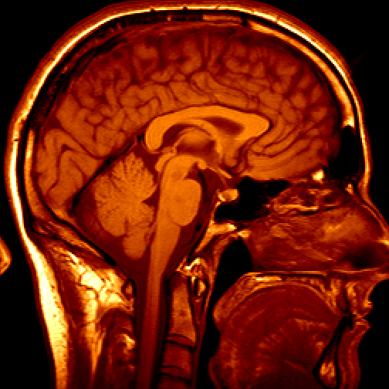
Application of Digital Image Processing
Medical Image
3D imaging
MRI, CT

Slide 22
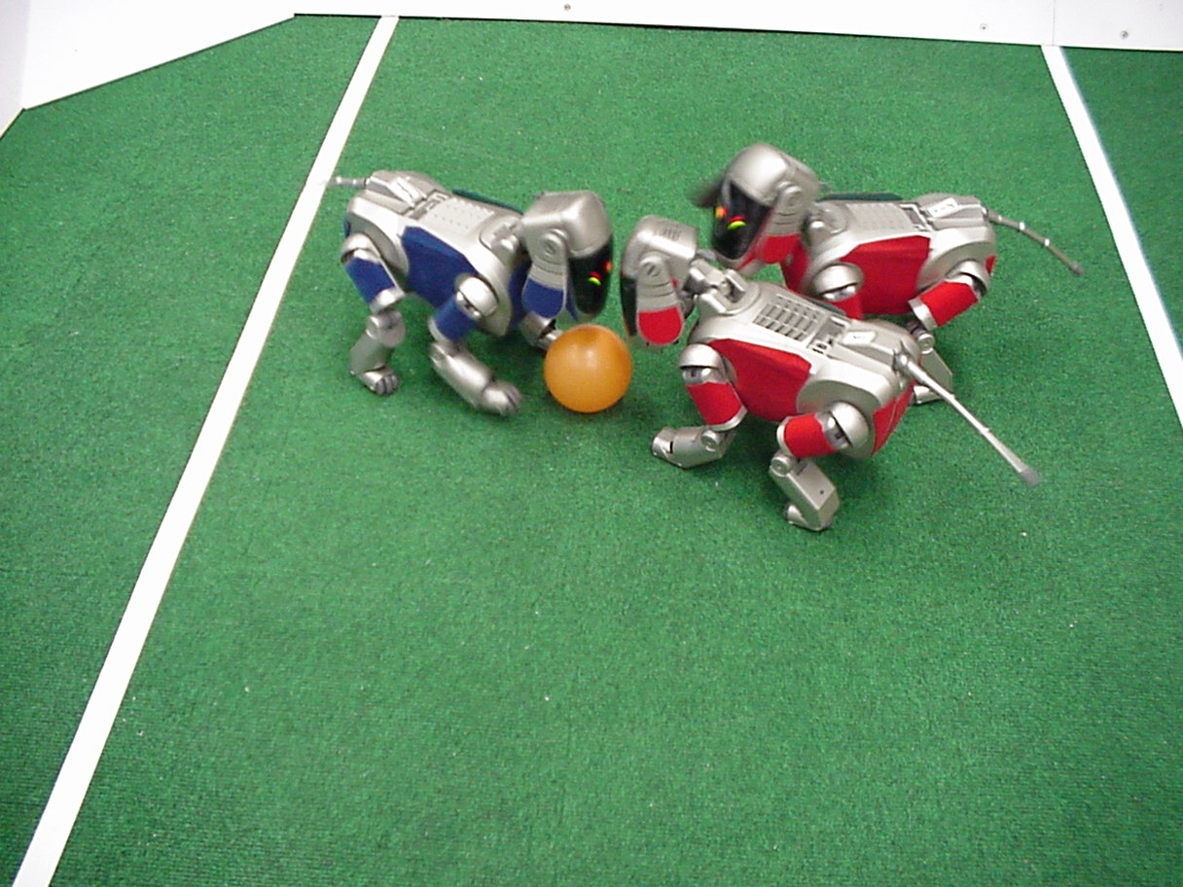

Application of Digital Image Processing
Robotics
http://www.robocup.org/
NASA’s Mars Spirit Rover
http://en.wikipedia.org/wiki/Spirit_rover

Slide 23
Basic steps in Digital Image Processing

Slide 24
CHAPTER 1: Digital image processing introduction
1.1 INTRODUCTION ABOUT DIGITAL IMAGE PROCESSING
1.2 CAMERA AND HUMAN VISUAL SYSTEM
1.3 REPRESENT A DIGITAL IMAGE AND COLOR SPACE

Slide 25
Camera and Human Perception System
Digital Image Sensor

Slide 26
Camera and Human Perception System
Digital Image Acquisition Process
Capture real object to image

Slide 27
Camera and Human Perception System
Digital Image Acquisition Process
Sampling and quantization

Slide 28
Camera and Human Perception System
Results of sampling and quantization

Slide 29
Camera and Human Perception System
Digital Image Acquisition Process
represent an image in 3D and 2 D

Slide 30
Camera and Human Perception System
Spatial resolution

Slide 31
Camera and Human Perception System
Intensity resolution
gray scale images 8 bits per pixels, i.e. 2 8 =256 intensity levels.
Color images are usually stored with 3x8 bits per pixels,
2^8 red intensity levels, 2^8 green intensity levels and 2^8 blue intensity levels.

Slide 32
Camera and Human Perception System
Intensity Resolution
Present by power of 2. ex) 2^8= 256 values form 0-255
More bits more detail

Slide 33
Camera and Human Perception System
Gray scale image compared to true color image

Slide 34
Camera and Human Perception System
The electromagnetic spectrum
Wavelength of difference source

Slide 35
Camera and Human Perception System
The electromagnetic spectrum
Examples of different images from different sources

Slide 36
Camera and Human Perception System
The electromagnetic spectrum
Examples of different images from different sources

Slide 37
Camera and Human Perception System
Examples of different images from different sources

Slide 38
Camera and Human Perception System
Human Visual system
The human eye contains 3 types of sensors named cones, sensible to blue, green and red light, respectively.
The human eye regards a color as a combination of 3 primary colors blue (B), green (G) and red (R).

Slide 39
Camera and Human Perception System
Human Visual system
Basically, the eye works much like a camera

Slide 40
CHAPTER 1: Digital image processing introduction
1.1 INTRODUCTION ABOUT DIGITAL IMAGE PROCESSING
1.2 CAMERA AND HUMAN VISUAL SYSTEM
1.3 REPRESENT A DIGITAL IMAGE AND COLOR SPACE

Slide 41
The Methods to represent Digital color image
The colors perceive in an object are determined by the nature of the light reflected from the object
E.g: green objects of 500 – 570 nm while absorbing most of the energy at other wavelengths
White Light
colors Absorbed
Green Light

Slide 42
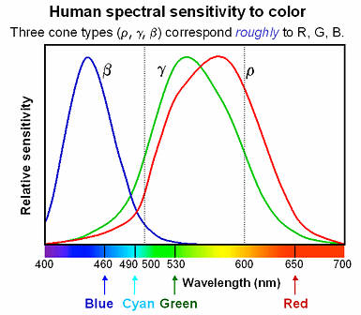
The Methods to represent Digital color image
Wavelength of the light

Slide 43
The Methods to represent Digital color image
3 basic qualities of a chromatic light source:
Radiance: the total amount of energy that flows from the light source (measured in watts)
Luminance: the amount of energy an observer perceives from the light source (measured in lumens)
Brightness: a subjective (practically unmeasurable) notion that embodies the intensity of light

Slide 44
The Methods to represent Digital color image
CIE 1931 XYZ system
One of the color spaces
The first mathematical defined color space
Three parameter:
X, Y, Z
or Y (brightness), x, y (chroma)

Slide 45
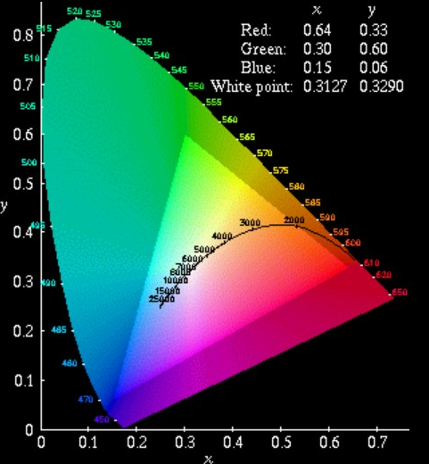
The Methods to represent Digital color image
CIE
Chromaticity Diagram
Spectral Locus
Parameter x, y

Slide 46
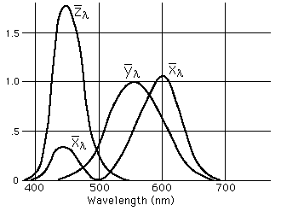
The Methods to represent Digital color image

Slide 47
The Methods to represent Digital color image
The CIE System
Y: the brightness
The Chroma parameter x, y :

Slide 48
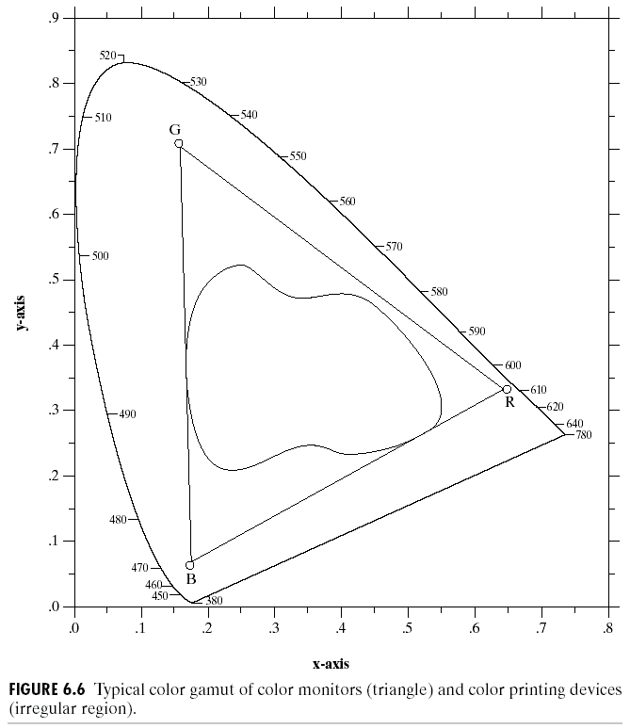
The Methods to represent Digital color image
CIE Chromacity Diagram
This means the entire color range cannot be displayed based on any three colors
The triangle shows the typical color gamut produced by RGB monitors
The strange shape is the gamut achieved by high quality color printers

Slide 49
The Methods to represent Digital color image
Color Space: What is color space?
A 3D model used to define a specified color
The difference between color spaces:
The choice of axes

Slide 50
The Methods to represent Digital color image
Two very popular models used in color image processing:
RGB (Red Green Blue)
HIS (Hue Saturation Intensity)

Slide 51
The Methods to represent Digital color image
RGB modle
Consist of three component images – one for each primary color
When fed into a monitor these images are combined to create a composite color image
The number of bits used to represent each pixel is referred to as the color depth
E.g: A 24-bit image is often referred to as a full-color image as it allows 16,777,216 colors

Slide 52
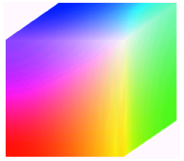
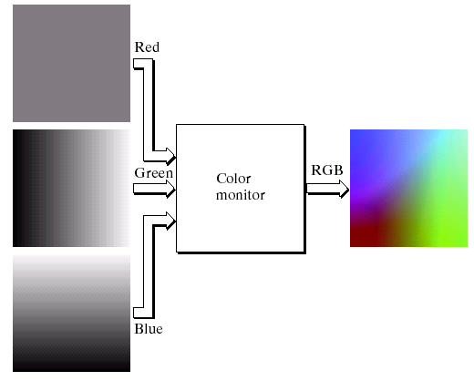
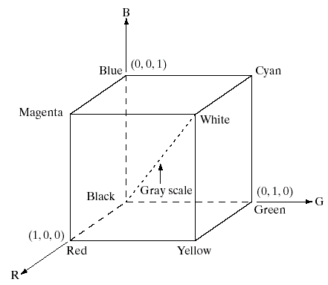
The Methods to represent Digital color image
RGB modle

Slide 53
The Methods to represent Digital color image
Color Space:
RGB
YCbCr (YPbPr)
YUV
YIQ
CMYK

Slide 54
The Methods to represent Digital color image
YCbCr & YPbPr
Used for: digital video encoding, digital camera
Axes:
Y: luma
Cb: blue chroma
Cr: red chroma

Slide 55
The Methods to represent Digital color image
Conversion from RGB:
Y=0.299(R-G) + G + 0.114(B-G)
Cb=0.564(B-Y)
Cr=0.713(R-Y)
The Matrix form:

Slide 56
The Methods to represent Digital color image
YUV
Used for: video encoding for some standard such as NTSC, PAL, SECAM
Axes:
Y: luma
U: blue chroma
V: red chroma

Slide 57
The Methods to represent Digital color image
Conversion from RGB:
Y=0.299R+0.587G+0.114B
U=0.436(B-Y)/(1-0.114)
V=0.615(R-Y)/(1-0.299)
The Matrix form:

Slide 58
represent a digital image and color space
The HSI color model
The HSI (Hue,(Hue, Saturation, Intensity)
Decouples thee intensity information from the color-carrying information.
Is good for describing monochromatic images

Slide 59
represent a digital image and color space
Hue (H) and saturation (S) the HSI model
good for describing colors

Slide 60
represent a digital image and color space
Color space | Color mixing | Primary parameters | Used for | Pros and cons
RGB | Additive | Red, Green, Blue |  | Easy but wasting bandwidth
CMYK | Subtractive | Cyan, Magenta, Yellow, Black | Printer | Works in pigment mixing
YCbCr YPbPr | additive | Y(luminance), Cb(blue chroma), Cr(red chroma) | Video encoding, digital camera | Bandwidth efficient
YUV | additive | Y(luminance), U(blue chroma), V(red chroma) | Video encoding for NTSC, PAL, SECAM | Bandwidth efficient
YIQ | additive | Y(luminance), I(rotated from U), Q(rotated from V) | Video encoding for NTSC | Bandwidth efficient

Slide 61
SUMMARY
This chapter we have learnt:
Define digital image .
Define basic digital image processing steps.
Digital image sensor and acquisition.
Color space models .

Slide 62
HOMEWORK
Review the chapter 1
Read chapter 2 : 23-65, 417-436
Reference [2]: 13-49
Solve the exercise: 2.1, 2.2, 2.4, 2.5, 2.7, 2.11, 2.12, 2.15, 2.20, 2.62.

